Slide 1
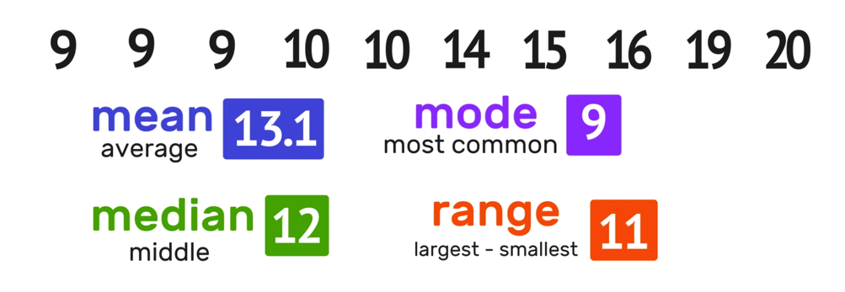
Maths for Machine Learning
Descriptive Statistics (Mean, Median, Mode, Variance, Standard Deviation)
Descriptive Statistics
(Mean, Median, Mode, Variance, Standard Deviation)

Slide 2
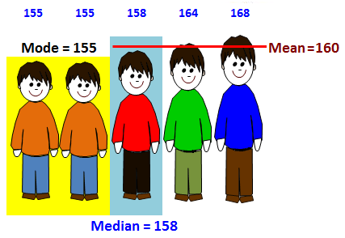
1. Mean (Average)
The mean (also called the arithmetic average) is a measure of central tendency that represents the average value of a dataset. It is calculated by summing all the values and then dividing by the number of values.
Formula = sum of all values / count of values
Data = [2,4,6,8,10]
Sum = (2 + 4 + 6 + 8 + 10) = 30
Mean = 30 / 5 = 6
Data = [10,10,20,20]
Sum = (10 + 10 + 20 + 20) = 60
Mean = 60 / 4 = 15

Slide 3
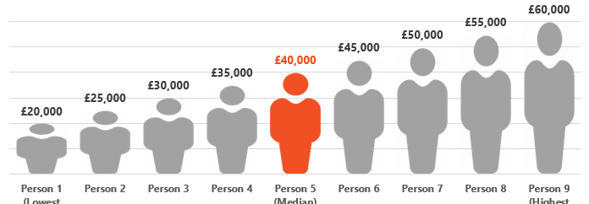
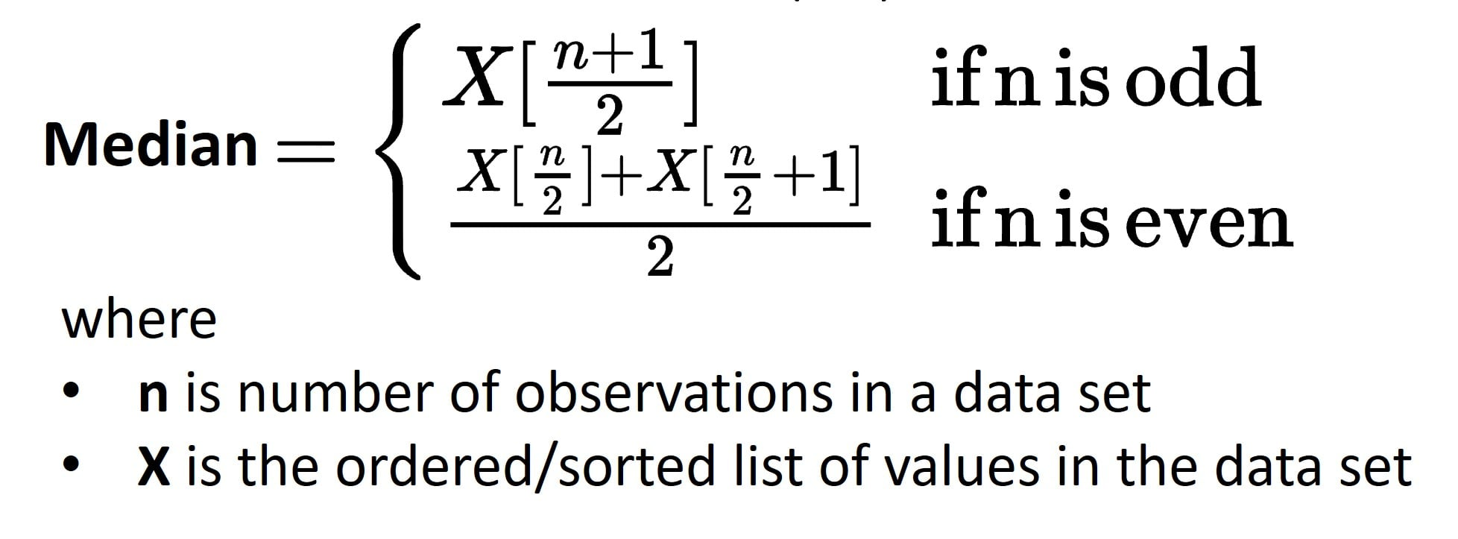
2. Median – Beech Ka Number Kya Hai?
The median is the middle value of a dataset when arranged in ascending or descending order.
How to Find the Median?
Step 1: Arrange the data in ascending order.
Step 2:
If (total number of values) is odd, the median is the middle value.
(1,2,3,4,5,6,7) = odd ( so 4 is median)
If it is even, the median is the average of the two middle values.
(1,2,3,4,5,6) = even (so average of 3 and 4 will be median)

Slide 4
2. Median – Beech Ka Number Kya Hai?
Data = (3, 7, 5)
Arrange = (3,5,7)
Middle value = 5
Data = (10, 20, 30, 40)
Average middle two values = (20 + 30) / 2 = 25
Median = 25
Data = (2, 4, 6, 8, 10)
Middle value = 6
Data = (1, 3, 5, 7, 9, 11)
Average middle two values = (5 + 7) / 2 = 6
Median = 6

Slide 5
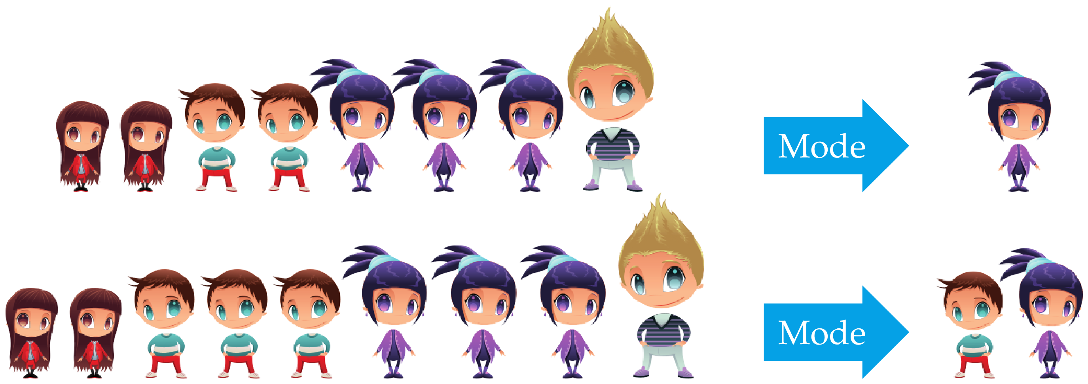
3. Mode – Sabse Zyada Common Value
The mode is the value that appears most frequently in a dataset.
Types of mode:
one mode (unimodal),
two modes (bimodal),
multiple modes (multimodal).
If all values appear equally, there is no mode.

Slide 6
3. Mode – Sabse Zyada Common Value
Example 1: Exam Scores (Unimodal)
Scores: 85, 90, 92, 85, 88, 90, 85, 91
Step 1: Count the occurrences of each value.
85 appears 3 times
90 appears 2 times
92, 88, and 91 appear once
Mode = 85 (since it appears the most)
Example 2: Shoe Sizes (Bimodal)
Sizes: 7, 8, 9, 7, 10, 8, 9, 7, 8, 9
Step 1: Count the occurrences of each value.
7 appears 3 times
8 appears 3 times
9 appears 3 times
10 appears once
Modes = 7, 8, and 9 (since they all appear most frequently—the dataset is multimodal).

Slide 7
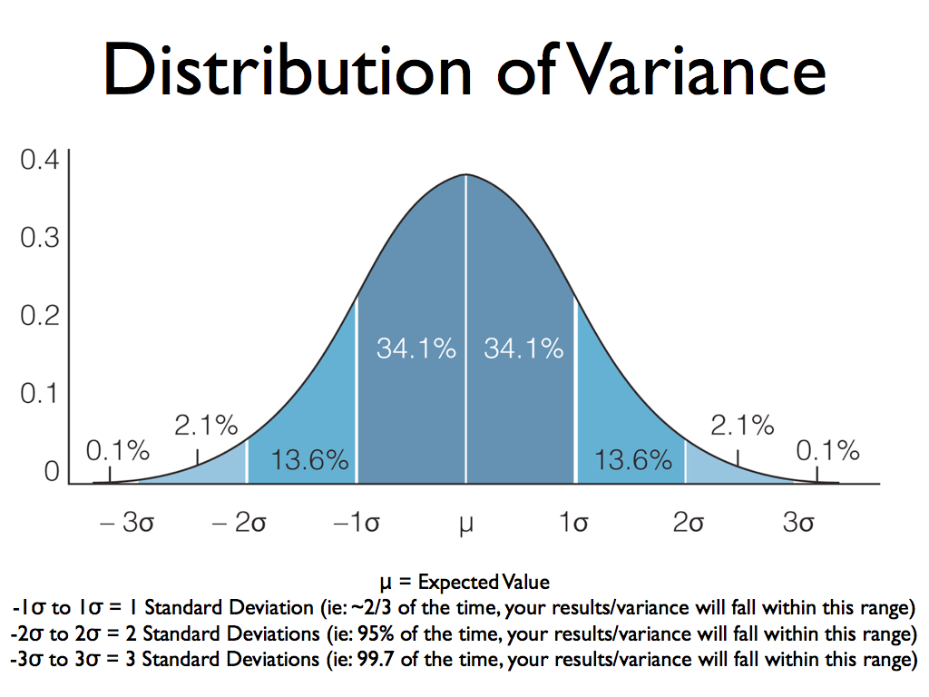
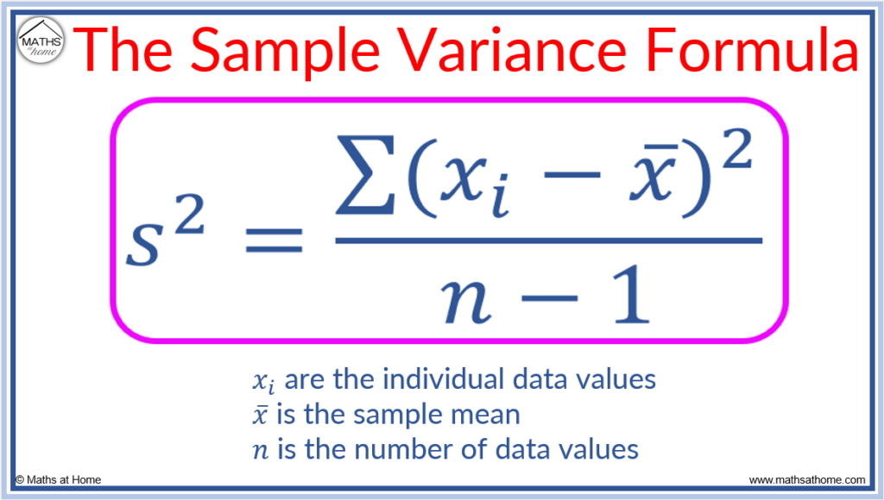
4. Variance – Data Kitna Spread Hai?
Variance measures how much the values in a dataset spread out from the mean. A higher variance means the values are more spread out, while a lower variance means the values are closer to the mean.
10, 20, 30, 40, 50

Slide 8
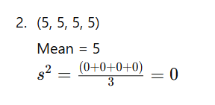
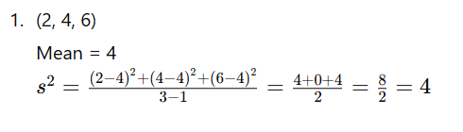
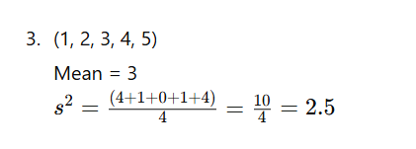
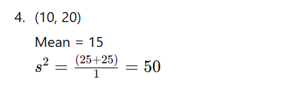
4. Variance – Data Kitna Spread Hai?

Slide 9
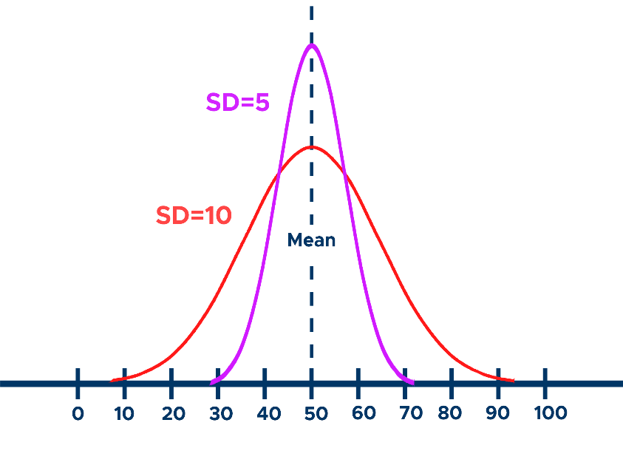

5. Standard Deviation – Variation Ka Asaan Estimate
Standard deviation is the square root of variance and measures how much the values in a dataset deviate from the mean. It is useful because it provides the spread of data in the same unit as the original values.

Slide 10
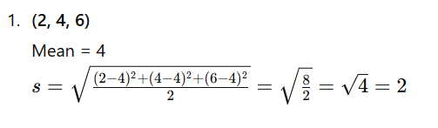
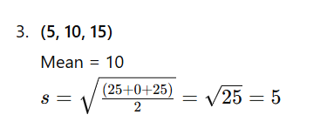
5. Standard Deviation – Variation Ka Asaan Estimate

